Slide 1
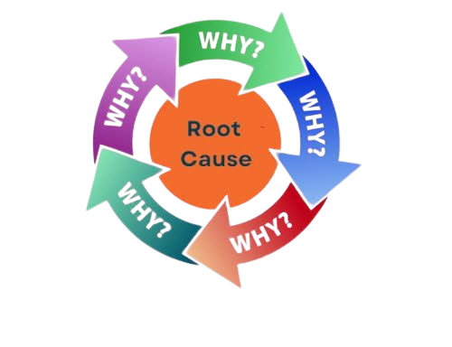
5 Why Analysis
Root Cause Analysis Technique
12th September 2025

Slide 2
Contents
Root Cause Analysis
5 Why Analysis
Importance Of 5 Why Analysis
5 Why Analysis Process Flow
Rules Of 5 Why Analysis
Benefits Of 5 Why Analysis
Limitations Of 5 Why Analysis
Summary

Slide 3
Root Cause Analysis

Slide 4
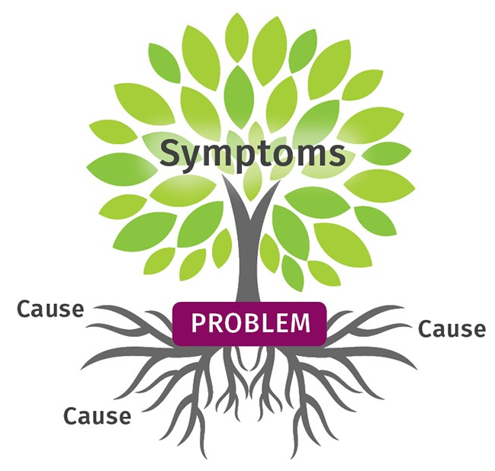
Root Cause Analysis
A structured method to identify the true cause of a problem.
Promotes continuous improvement and process reliability.
Solving issues at their source, not just symptoms.
Techniques:
5 Why Analysis
Fishbone Diagram (Ishikawa Diagram)
Pareto Chart
Fault Tree Analysis (FTA)

Slide 5
5 Why Analysis

Slide 6
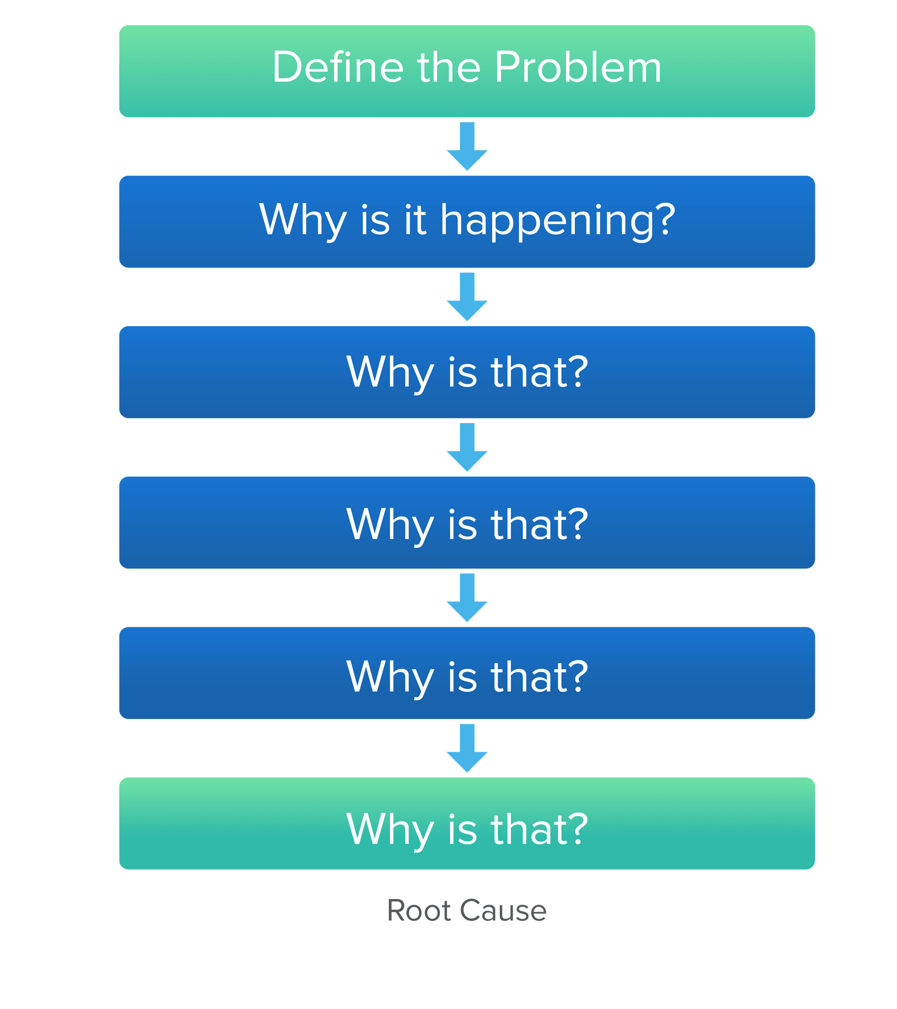
5 Why Analysis
A root cause analysis method involves repeatedly asking “Why?”
Uncovers the core reason behind a problem.
Get Root cause in 4th or 5th Why?
Purpose:
To drill down into the cause-and-effect relationships of a problem.
To identify the root cause rather than just treating symptoms.
To prevent recurrence by addressing the true source of the issue.

Slide 7
Importance Of 5 Why Analysis

Slide 8
Why It Matters & Impact on Work
Importance Of 5 Why
Critical thinking
Accountability
Learning mindset
Better communication
Impact On Work
Time efficiency
Confidence boost
Growth opportunities
Task clarity

Slide 9
5 Why Analysis Process Flow

Slide 10
5 Why Analysis Process Flow
Problem: Coming Late to Office.
Why? : I took the bus late in the morning.
Why? : I woke-up late.
Why? : Alarm didn’t ring.
Why? : Phone was switched off.
Why?
(Root Cause)
:
Didn’t charge the phone before sleep.

Slide 11
Rules Of 5 Why Analysis

Slide 12
Rules Of 5 Why Analysis
State the problem clearly.
Ask "why" one at a time.
Base answers on facts, not assumptions.
Verify the root cause.
Stop When you find the root cause.
Document the process.

Slide 13
Benefits Of 5 Why Analysis

Slide 14
Benefits Of 5 Why Analysis
Simplicity and Ease of Use.
Encourages Deep Thinking.
Identifies Root Causes.
Promotes Team Collaboration.
Cost-Effective.
Supports Lean and Agile Practices.

Slide 15
Limitations Of 5 Why Analysis

Slide 16
Limitations Of 5 Why Analysis
Missing parallel causes.
Relies on Investigator's Knowledge and Experience.
Not Always Repeatable.
Not a Data-Driven Method.
Can Focus on Symptoms Rather Than Root Causes.

Slide 17
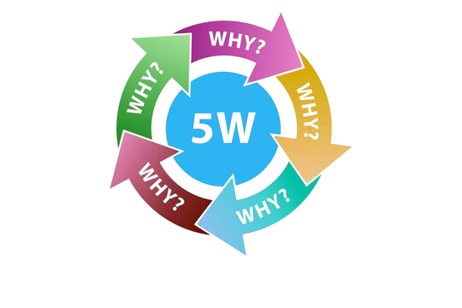
Summary
5 Whys uncover the root, not just the symptom.
Simple questions lead to deep insights.
Clarity begins with curiosity.
Solving problems means understanding causes.
Limitations guide better application.

Slide 18
Thank You!
Team No: 1

